Slide 1
PROJ 216 Software Project Concepts
Day 5

Slide 2
Day 5 Agenda
Class Diagram Demo (MS Visio)
Class Diagram Exercise
More UML Diagrams
Package diagram
State transition diagrams
Sequence diagrams
System Architecture
Client/Server
Multi-Tiered
Web Architecture
Workshop: finish UML Class Diagram– due 8 a.m. on Day 6

Slide 3
UML – Package Diagram
Relevant for medium to large size systems
Shows how classes are grouped into packages
Shows relationships between packages (e.g. one package imports another)

Slide 4
UML – Sequence Diagrams
Created for a use case
Multiple sequence diagrams for one use case show steps of different paths through the use case
Shows objects involved in the behaviour
Models sequence of events (interaction between objects)
which methods are called, arguments that are passed
Organized along time flow
http://www.agilemodeling.com/artifacts/sequenceDiagram.htm

Slide 5
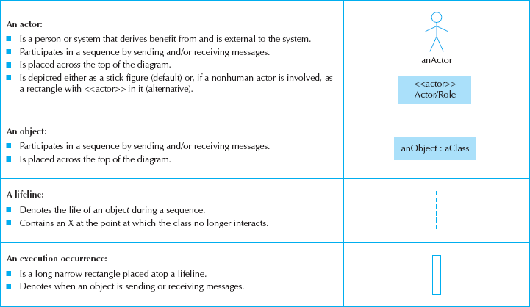
Sequence Diagram Syntax

Slide 6
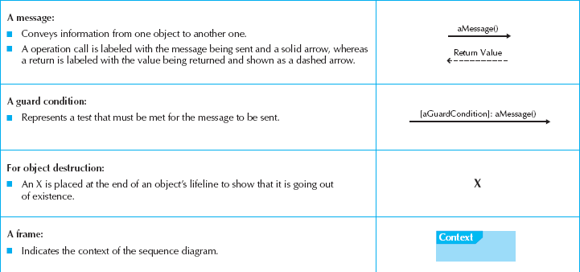
More Sequence Diagram Syntax

Slide 7
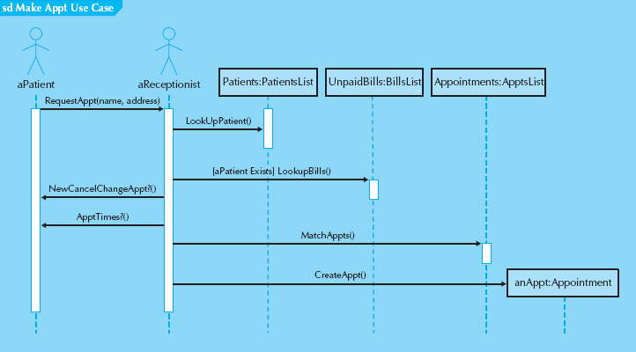
Sample Sequence Diagram

Slide 8
Steps to Build Sequence Diagrams
Set the context
Identify which objects will participate
Set the lifeline for each object
Lay out the messages from top to bottom of the diagram based on the order in which they are sent
Add execution occurrence to each object‘s lifeline
Validate the sequence diagram

Slide 9
Can You Read This Diagram?

Slide 10
UML – Collaboration Diagrams
Same information as sequence diagrams, but focused on objects’ interaction rather than time sequencing
Time flow represented by numbering of messages
Collaboration diagram can usually be automatically generated from sequence diagram and vice versa
http://stackoverflow.com/questions/14319015/differences-between-sequence-diagram-and-collaboration-diagram

Slide 11
UML – State Transition Diagrams
Created for objects that exhibit non-trivial behaviour
Shows changes of object’s states over time
State changes are triggered by events
May also show action that accompany state change
http://www.agilemodeling.com/artifacts/stateMachineDiagram.htm

Slide 12
State Transition Diagram
Applies to only one object
Only events that significantly change object state are included
Only classes with significant behaviour have states
State is a time-span between 2 events
State variables = properties of the object
Events trigger state transitions
Actions = object’s response to transitions

Slide 13
State Transition Diagram

Slide 14
State Transition Diagram
Booking a Flight

Slide 15
Exercise
Draw a state transition diagram for a garage door opener

Slide 16
Component Diagram
Component diagram shows physical design of software components, interfaces and ports
http://www.uml-diagrams.org/component-diagrams.html

Slide 17
Deployment Diagram
Deployment diagram shows physical nodes and components that runs of these nodes
http://www.agilemodeling.com/artifacts/deploymentDiagram.htm

Slide 18
Information System Architecture
Client-Server
Multi-Tiered
Web Architecture

Slide 19
Client/Server Architecture
Client functions
formatting & display
data entry & transmission to server
query building
Server functions
processing requests from many clients
locking, sharing
load balancing
transaction processing

Slide 20
Multi-Tiered Architecture
MVC – Model-View-Controller
Presentation Layer
thin client
validation
Business Layer
processing logic
validation
Data Layer
data processing
Additional layers, e.g. middleware

Slide 21
Web Architecture
client
Internet
web server
application server
database server

Slide 22
UML Class Diagram Assignment
Class diagram that shows classes, their attributes and operations, and relationships between the classes. Make sure to indicate cardinality at the ends of relationships wherever applicable
DUE DATE: 8:00 a.m. on Day 6
Create one copy of each diagram per group, but each student submits through learn.sait.ca

